Slide 1
Endpoint Security
Instructor Materials
Networking Security v1.0
Notes:
Networking Security (NETSEC)
Module 13: Endpoint Security

Slide 2
Instructor Materials – Module 13 Planning Guide
This PowerPoint deck is divided in two parts:
Instructor Planning Guide
Information to help you become familiar with the module
Teaching aids
Instructor Class Presentation
Optional slides that you can use in the classroom
Begins on slide # 8.
Note: Remove the Planning Guide from this presentation before sharing with anyone.
For additional help and resources go to the Instructor Home Page and Course Resources for this course. You also can visit the professional development site on netacad.com, the official Cisco Networking Academy Facebook page, or Instructor Only FB group.

Slide 3
What to Expect in this Module
To facilitate learning, the following features within the GUI may be included in this module:
Feature | Description
Animations | Expose learners to new skills and concepts.
Videos | Expose learners to new skills and concepts.
Check Your Understanding(CYU) | Per topic online quiz to help learners gauge content understanding.
Interactive Activities | A variety of formats to help learners gauge content understanding.
Syntax Checker | Small simulations that expose learners to Cisco command line to practice configuration skills.
PT Activity | Simulation and modeling activities designed to explore, acquire, reinforce, and expand skills.

Slide 4
What to Expect in this Module (Cont.)
To facilitate learning, the following features may be included in this module:
Feature | Description
Hands-On Labs | Labs designed for working with physical equipment.
Class Activities | These are found on the Instructor Resources page. Class Activities are designed to facilitate learning, class discussion, and collaboration.
Module Quizzes | Self-assessments that integrate concepts and skills learned throughout the series of topics presented in the module.
Module Summary | Briefly recaps module content.

Slide 5
Check Your Understanding
Check Your Understanding activities are designed to let students quickly determine if they understand the content and can proceed, or if they need to review.
Check Your Understanding activities do not affect student grades.
There are no separate slides for these activities in the PPT. They are listed in the notes area of the slide that appears before these activities.
Notes:
<number>

Slide 6
Module 13: Activities
What activities are associated with this module?
Page # | Activity Type | Activity Name | Optional?
13.1.9 | Check your Understanding | Identify Endpoint Security Terminology | Recommended
13.2.4 | Syntax Checker | Configure 802.1x Port-Authentication | Recommended
13.3.2 | Module Quiz | Endpoint Security Summary | Recommended

Slide 7
Module 13: Best Practices
Prior to teaching Module 13, the instructor should:
Review the activities and assessments for this module.
Try to include as many questions as possible to keep students engaged during classroom presentation.
Topic 13.1
Ask the class “Assume your company is letting employees use their own devices to work on the corporate network. What would you do to secure the network?” Elicit answers to implement antimalware software, host-based IPS and firewall features, and encrypting data. Network access control (NAC) is used to enable only compliant devices and authorized users to access the network.
Topic 13.2
Ask the class “How do you authenticate hosts on a network?”
Explain that “Organizations use the 802.1X port authentication protocol to authenticate users or devices.”
Notes:
<number>

Slide 8
Module 13: Endpoint Security
Networking Security v1.0
(NETSEC)
Notes:
Networking Security (NETSEC)
Module 13: Endpoint Security

Slide 9
Module Objectives
Module Title: Endpoint Security
Module Objective: Explain endpoint vulnerabilities and protection methods.
Topic Title | Topic Objective
Endpoint Security Overview | Describe endpoint security and the enabling technologies.
802.1X Authentication | Explain the functions of 802.1x components.
Notes:
<number>
13 – Endpoint Security
13.0.2 – What will I learn to do in this module?

Slide 10
13.1 Endpoint Security Overview
Notes:
13: Endpoint Security
13.1: Endpoint Security Overview

Slide 11
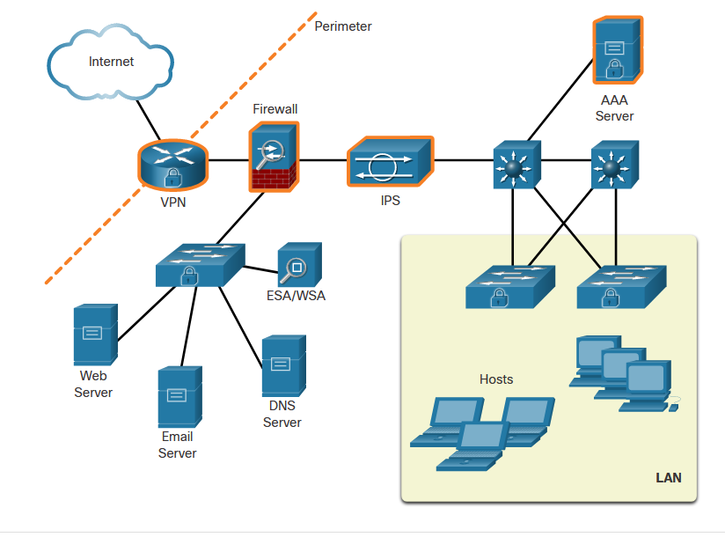
Endpoint Security Overview
LAN Elements Security
Various network security devices are required to protect the network perimeter from outside access. As shown in the figure, these devices could include a hardened ISR that is providing VPN services, an ASA firewall appliance, an IPS, and a AAA server.
Because many attacks originate from inside the network, securing an internal LAN is just as important as securing the outside network perimeter.
Specifically, there are two internal LAN elements to secure:
Endpoints
Network infrastructure
Notes:
13: Endpoint Security
13.1: Endpoint Security Overview
13.1.1: LAN Elements Security

Slide 12
Endpoint Security Overview
Traditional Endpoint Security
Historically, employee endpoints were company-issued computers which resided within a clearly defined LAN perimeter. These hosts were protected by firewalls and IPS devices which worked well with hosts that were connected to the LAN and behind the firewall.
The endpoints also used traditional host-based security measures:
Antivirus/Antimalware Software
Host-based IPS
Host-based firewall
Notes:
13: Endpoint Security
13.1: Endpoint Security Overview
13.1.2: Traditional Endpoint Security

Slide 13
Endpoint Security Overview
The Borderless Network
The new bring-your-own-device (BYOD) needs of workers have a required a different way of approaching endpoint security.
In many networks, the network-based devices are disparate and typically do not share information among themselves. Additionally, new endpoint devices are not good candidates for the traditional host-based endpoint security solutions because of the variety of devices and the variety of operating systems available on those devices.
Notes:
13: Endpoint Security
13.1: Endpoint Security Overview
13.1.3: The Borderless Network

Slide 14
Endpoint Security Overview
Security for Endpoints in the Borderless Network
Organizations must also protect their endpoints from new threats and provide the protection measures that are outlined in the table below:
Measure | Purpose
antimalware software | Protect endpoints from malware.
spam filtering | Prevent spam emails from reaching endpoints.
blocklisting | Prevent endpoints from connecting to websites with bad reputations by immediately blocking connections based on the latest reputation intelligence.
data loss prevention (DLP) | Prevent sensitive information from being lost or stolen.
Notes:
13: Endpoint Security
13.1: Endpoint Security Overview
13.1.4: Security for Endpoints in the Borderless Network

Slide 15
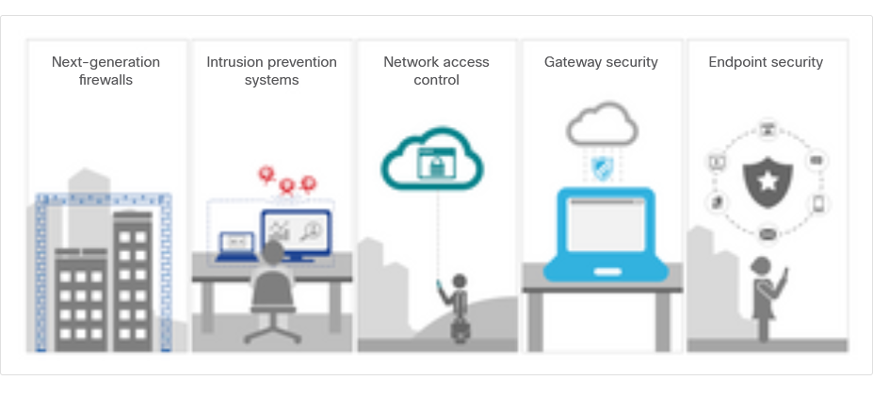
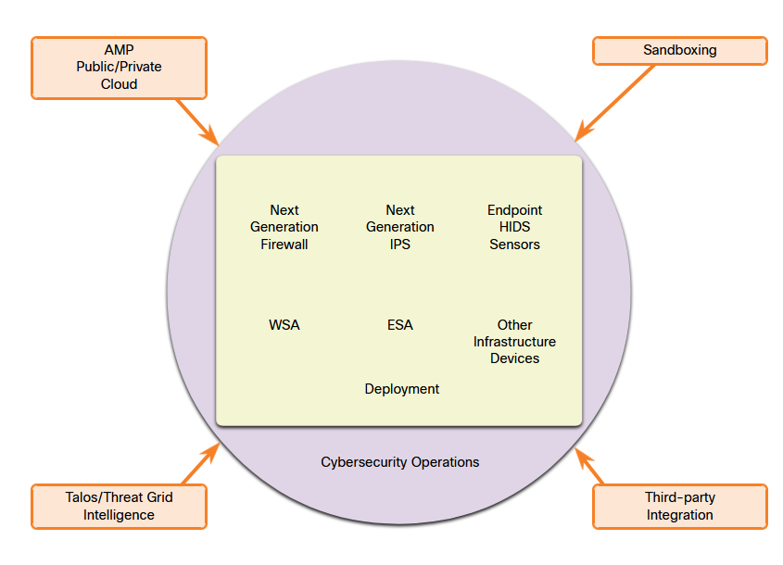
Endpoint Security Overview
Network-Based Malware Protection
Protecting endpoints in a borderless network can be accomplished using network-based, as well as host-based techniques, as shown in the figure.
The following are examples of devices and techniques that implement host protections at the network level:
Advanced Malware Protection (AMP)
Email Security Appliance (ESA)
Web Security Appliance (WSA)
Network Admission Control (NAC)
Notes:
13: Endpoint Security
13.1: Endpoint Security Overview
13.1.5: Network-Based Malware Protection

Slide 16
Endpoint Security Overview
Hardware and Software Encryption of Local Data
Endpoints are also susceptible to data theft. For instance, if a corporate laptop is lost or stolen, a thief could scour the hard drive for sensitive information, contact information, personal information, and more.
The solution is to locally encrypt the disk drive with a strong encryption algorithm such as 256-bit AES encryption. The encryption protects the confidential data from unauthorized access. The encrypted disk volumes can only be mounted for normal read/write access with the authorized password.
Notes:
13: Endpoint Security
13.1: Endpoint Security Overview
13.1.6: Hardware and Software Encryption of Local Data

Slide 17
Endpoint Security Overview
Network Access Control
The purpose of network access control (NAC) is to allow only authorized and compliant systems, whether managed or unmanaged, to access the network. It unifies endpoint security technologies with user or device authentication and network security policy enforcement.
NAC systems can have the following capabilities:
Profiling and visibility – This recognizes and users and their devices before malicious code can cause damage.
Guest network access – This manages guests through a customizable, self-service portal that includes guest registration, guest authentication, guest sponsoring, and a guest management portal.
Security posture checking – This evaluates security-policy compliance by user type, device type, and operating system.
Incident response - Mitigating network threats by enforcing security policies that block, isolate, and repair noncompliant machines without administrator attention.
Notes:
13: Endpoint Security
13.1: Endpoint Security Overview
13.1.7: Network Access Control

Slide 18
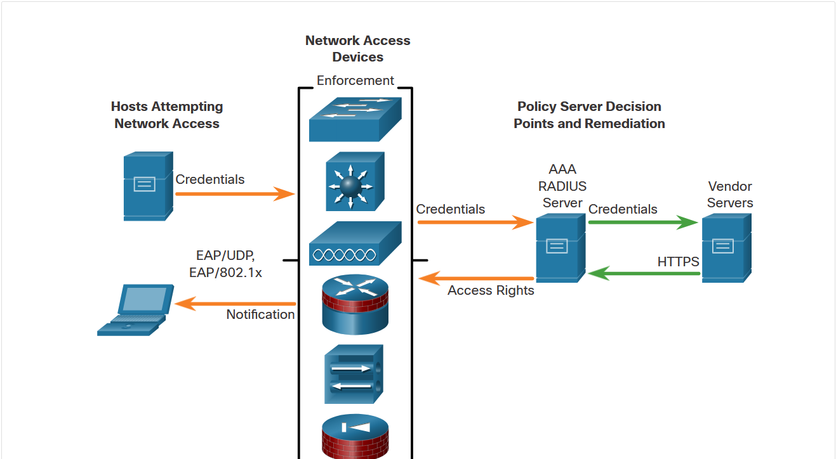
Endpoint Security Overview
NAC Functions
The goal of NAC systems is to ensure that only hosts that are authenticated and have had their security posture examined and approved are permitted onto the network.
Network access devices can function as the enforcement layer, as shown in the figure. They force the clients to query a RADIUS server for authentication and authorization. The RADIUS server can query other devices, such as an antivirus server, and reply to the network enforcers.
Notes:
13: Endpoint Security
13.1: Endpoint Security Overview
13.1.8: NAC Functions
13.1.9: Check Your Understanding - Identify Endpoint Security Terminology

Slide 19
13.2 802.1X Authentication
Notes:
13: Endpoint Security
13.2: 802.1X Authentication

Slide 20
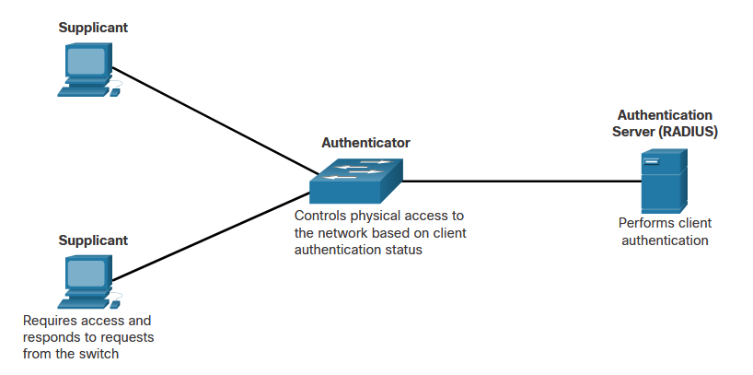
802.1X Authentication
Security Using 802.1X Port-Based Authentication
The IEEE 802.1X standard defines a port-based access control and authentication protocol that restricts unauthorized workstations from connecting to a LAN through publicly accessible switch ports. The authentication server authenticates each workstation that is connected to a switch port before making available any services offered by the switch or the LAN.
The figure shows that with 802.1X port-based authentication, the devices in the network have specific roles.
Notes:
13: Endpoint Security
13.2: 802.1X Authentication
13.2.1: Security Using 802.1X Port-Based Authentication

Slide 21
802.1X Authentication
Security Using 802.1X Port-Based Authentication (Cont.)
The 802.1x roles include:
Supplicant (Client) - The device (workstation) that requests access to LAN and switch services and then responds to requests from the switch. The workstation must be running 802.1X-compliant client software. (The port that the client is attached to is the supplicant [client] in the IEEE 802.1X specification.)
Authenticator (Switch) - Controls physical access to the network based on the authentication status of the client. The switch acts as an intermediary (proxy) between the client (supplicant) and the authentication server, requesting identifying information from the client, verifying that information with the authentication server, and relaying a response to the client. The switch uses a RADIUS software agent, which is responsible for encapsulating and de-encapsulating the EAP (Extensible Authentication Protocol) frames and interacting with the authentication server.
Authentication server - Performs the actual authentication of the client. The authentication server validates the identity of the client and notifies the switch whether the client is authorized to access the LAN and switch services. Because the switch acts as the proxy, the authentication service is transparent to the client. The RADIUS security system with EAP extensions is the only supported authentication server.
Notes:
13: Endpoint Security
13.2: 802.1X Authentication
13.2.1: Security Using 802.1X Port-Based Authentication

Slide 22
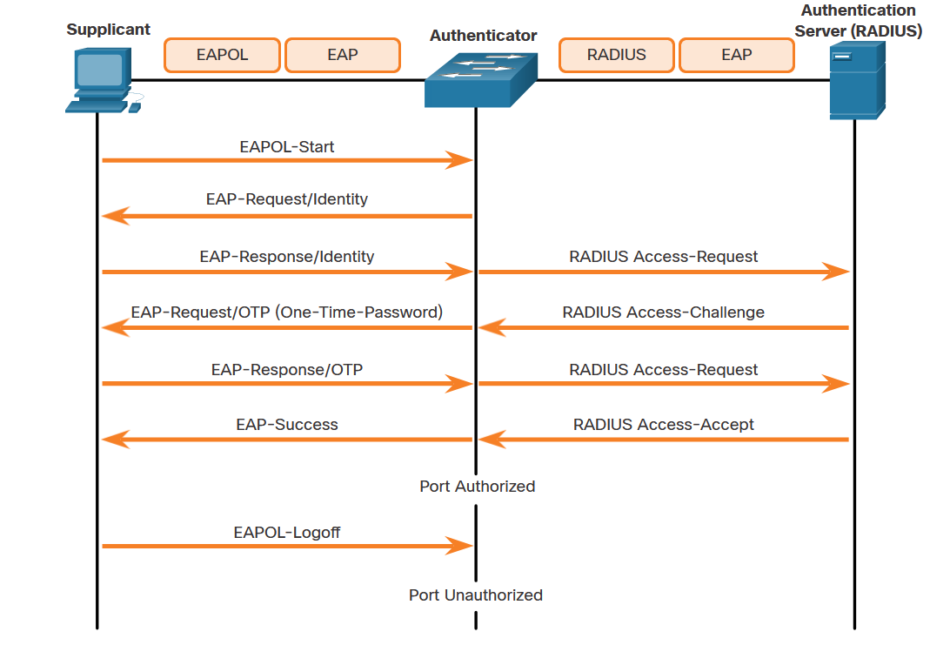
802.1X Authentication
Security Using 802.1X Port-Based Authentication (Cont.)
The figure shows the complete message exchange between the supplicant, authenticator, and the authentication server. The encapsulation occurs as follows:
Between the supplicant and the authenticator - EAP data is encapsulated in EAPOL frames.
Between the authenticator and the authentication server - EAP data is encapsulated using RADIUS.
Notes:
13: Endpoint Security
13.2: 802.1X Authentication
13.2.1: Security Using 802.1X Port-Based Authentication

Slide 23
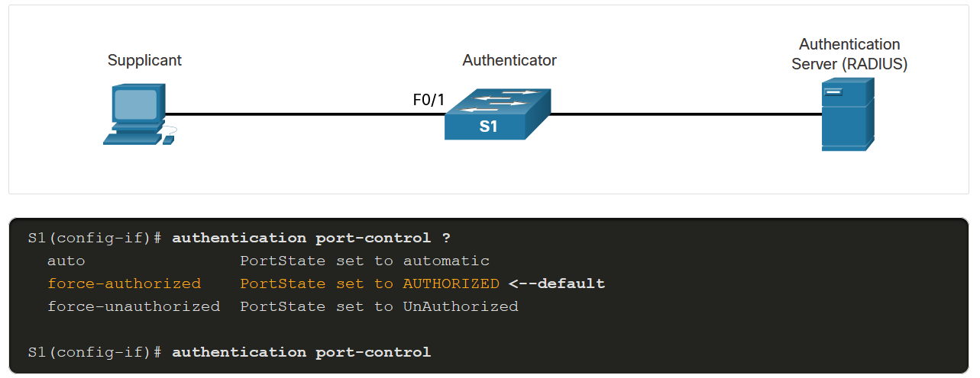
802.1X Authentication
Control the 802.1X Authorization State
It may be necessary to configure a switch port to override the 802.1X authentication process. To do this, use the authentication port-control interface configuration command to control the port authorization state. The syntax for the command and a description of the parameters are shown below.
Parameter | Description
auto | Enables 802.1X port-based authentication and causes the port to begin in the unauthorized state. During this time only EAPOL, STP, and CDP frames are the only type of frames that can be sent or received through the port until the client device has been authenticated.
force-authorized | The port sends and receives normal traffic without 802.1x-based authentication of the client. This is the default setting.
force-unauthorized | Causes the port to remain in the unauthorized state, ignoring all attempts by the client to authenticate. The switch cannot provide authentication services to the client through the port.
Notes:
13: Endpoint Security
13.2: 802.1X Authentication
13.2.2: Control the 802.1X Authorization State

Slide 24
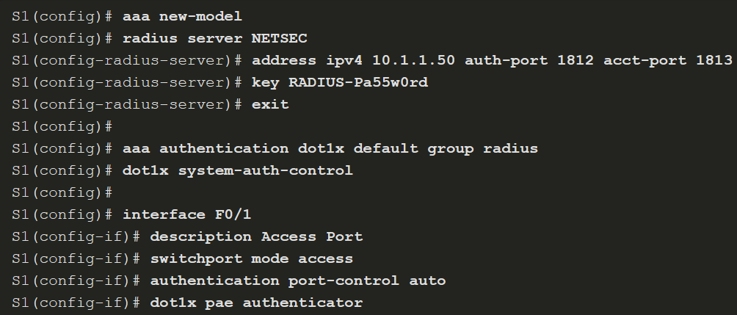
802.1X Authentication
802.1X Configuration
802.1X Configuration requires a few basic steps:
Step 1. Enable AAA using the aaa new-model command.
Step 2. Designate the RADIUS server and configure its address and ports.
Step 3. Create an 802.1X port-based authentication method list using the aaa authentication dot1x command.
Notes:
13: Endpoint Security
13.2: 802.1X Authentication
13.2.3: 802.1X Configuration
13.2.4: Syntax Checker - Configure 802.1x Port-Authentication

Slide 25
802.1X Authentication
802.1X Configuration (Cont.)
Step 4. Globally enable 802.1X port-based authentication using the dot1x system-auth-control command.
Step 5. Enable port-based authentication on the interface using the authentication port-control auto command.
Step 6. Enable 802.1X authentication on the interface using the dot1x pae command. The authenticator options sets the Port Access Entity (PAE) type so the interface acts only as an authenticator and will not respond to any messages meant for a supplicant.
Notes:
13: Endpoint Security
13.2: 802.1X Authentication
13.2.3: 802.1X Configuration
13.2.4: Syntax Checker - Configure 802.1x Port-Authentication

